Slide 1
APPLICATIONS OF HS PET FILM

Slide 2
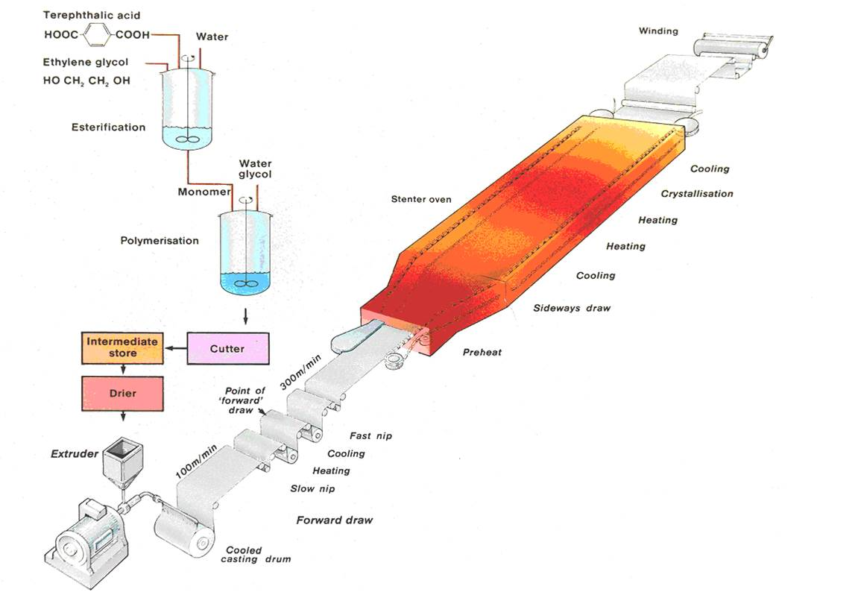
BOPET FILM Machine

Slide 3
BoPET (biaxially-oriented polyethylene terephthalate) is a polyester film made from stretched polyethylene terephthalate (PET) and is used for its high tensile strength, chemical and dimensional stability, transparency, reflectivity, gas and aroma barrier properties, and electrical insulation. A variety of companies manufacture boPET and other polyester films under different brand names.

Slide 4
HS PET FILM
HS grade product is a Bi-axially oriented transparent polyester film (co-extruded layer with special copolymer) with one surface being heat sealable. The special copolymer layer is designed to heat seal on itself as well as with substrates such as A- PET, C-PET, modified C-PET & A-PET coated boards.
A major benefit of heat sealable polyester is that it has high temperature resistance with a sealing range of typically 110-190°C.

Slide 5
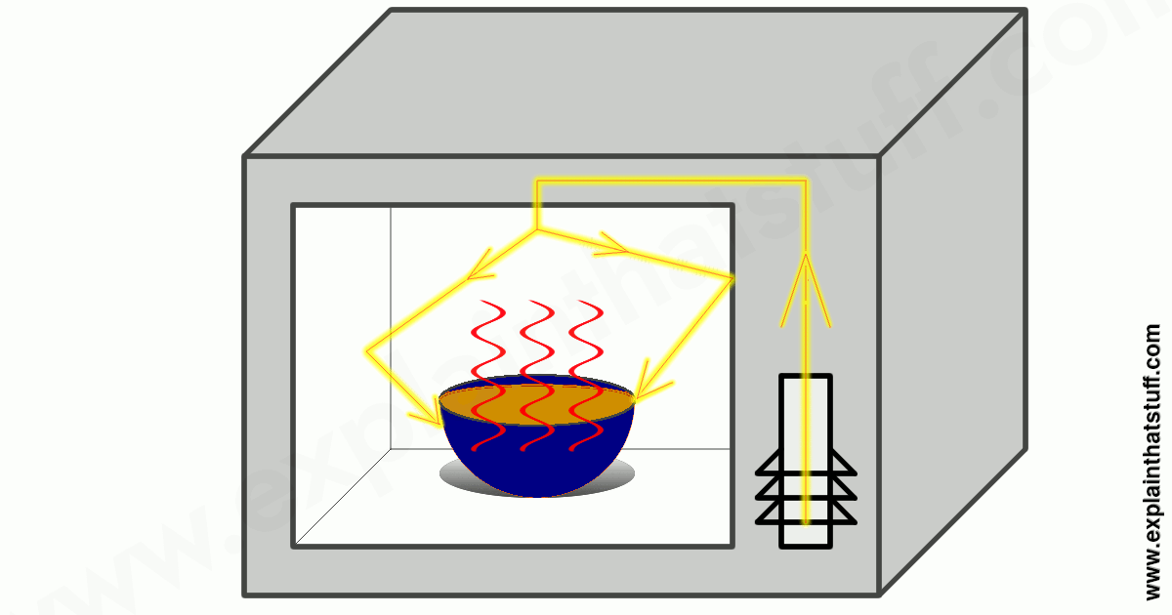
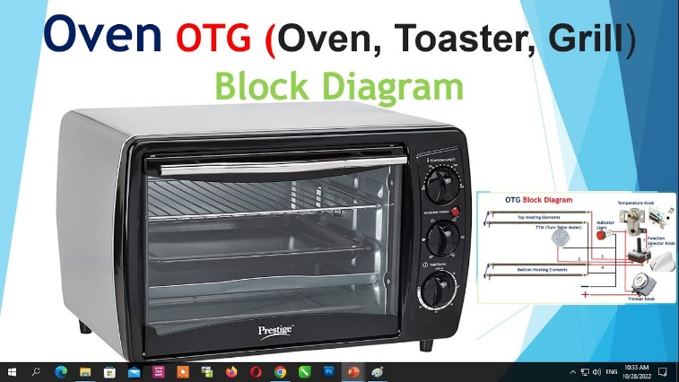
Advantages of HS PET film
DUAL Ovenable – Microwaveable & OTG oven
Sealable – High Seal Integrity
Sealable to APET , CPET , PVC , PVDC and Self
Can be laminated to non Woven PET without glue
Can withstand extreme temperature – Cold to High
Rigid
Printable

Slide 6
HS PET Applications
Application:
Heat sealable pet film can be used for food packaging- Overwraps
Heat sealable pet film can be used for roasting or cooking bags
Heat sealable pet film can be used for metal lamination
Heat sealable pet film also can be used for protective surfaces on glass fiber reinforced sheets
Heat Sealable Pet Film for lidding film
Heat sealable pet film for mosquito’s repellent coil packing

Slide 7
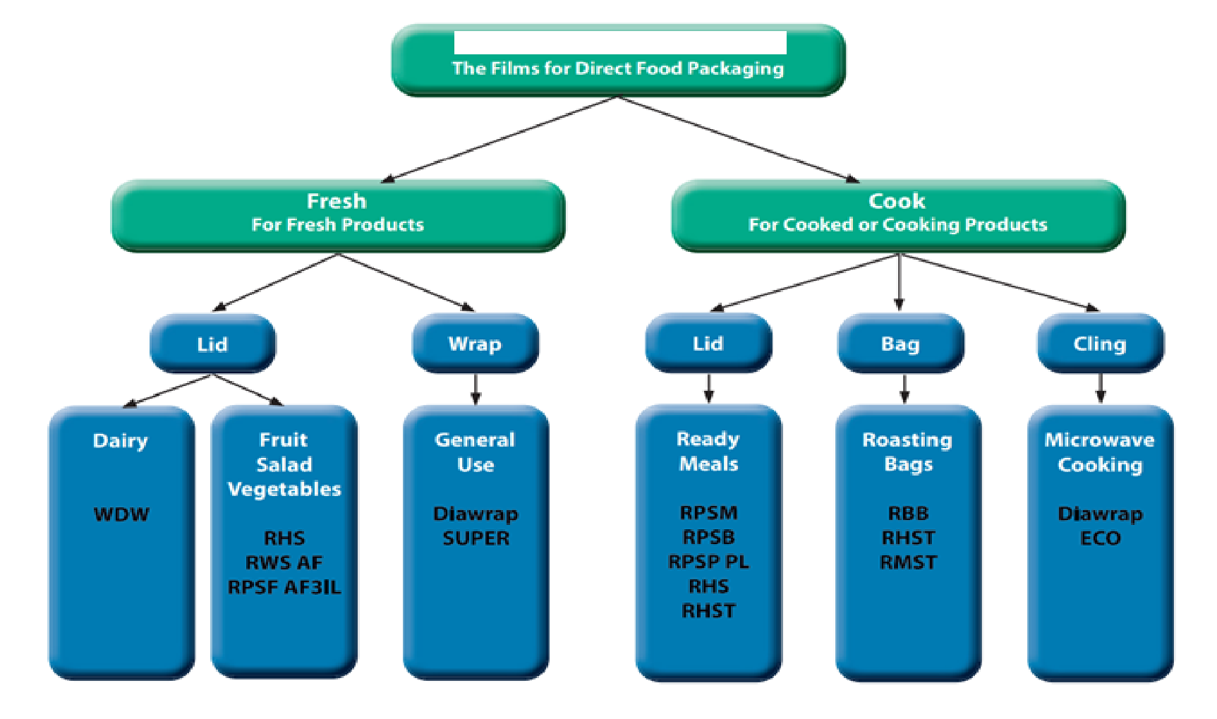
Based on Direct Food Packaging Application

Slide 8
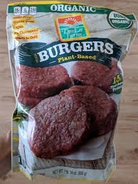
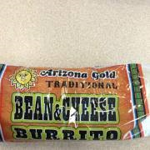
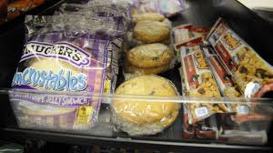
Flexible Packaging – Pouching
It is used for Packing red meat – First Refrigerated and then Microwaved
Used for Burger packing
Used for School food packing

Slide 9
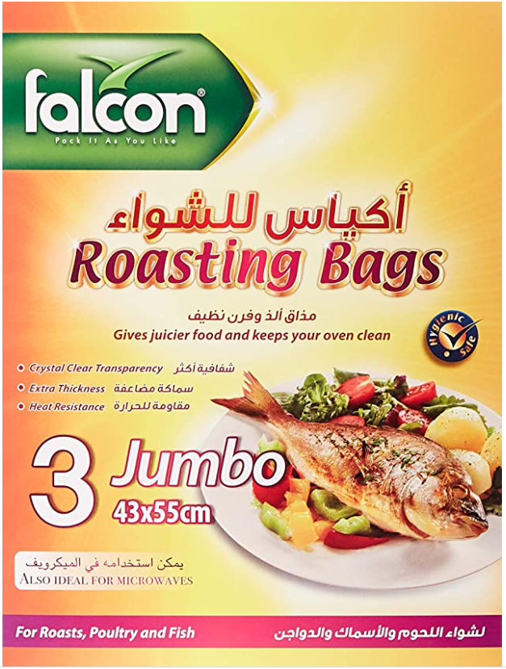
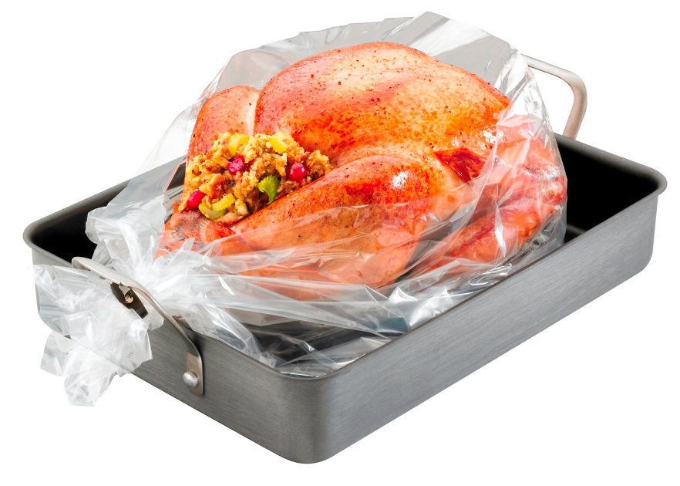
Chicken/ Turkey Cooking Bags
Bags for cooking chicken/ Fish/Turkey are made of HS PET or Antimony Free films as these are clear and Heat resistant

Slide 10
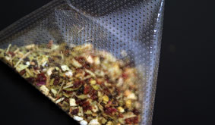
Tea Bags
Tea Bag
HS PET in Tea Bag line revolutionizes how tea will be brewed in the future.
Tea packers will now be able to offer their blends in a variety of perforated HS PET film Featuring a range of transparencies and perforation patterns, it also allows packagers to entice customers with enhanced visual presentations of their tea leaves.
These products offer greater infusion for better-tasting products and cost savings over traditional spun-bond woven Nylon and Abaca-based filter paper as well.
Highly versatile, this substrates can be run on almost all current tea-packaging machines with no changes to equipment or production.

Slide 11
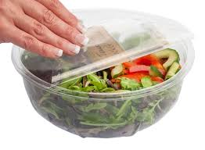
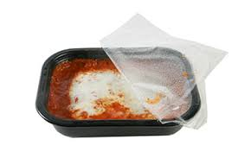
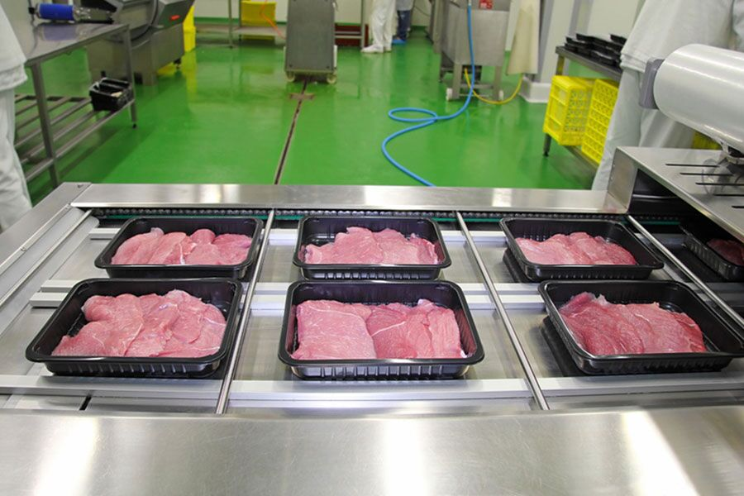
Lidding Film
HS PET films are first choice for use in lidding of APET / CPET trays & Cups
Lidding films are available in both easy-peel and lock-tight versions. With easy-peel, as the name would suggest, the consumer can peel the film from the container with relative ease. On the other hand, lock-tight films seal so tightly; you need a tool (such as scissors or a knife) to gain access to the product.
These film can seal Trays or containers made of APET , CPET, PVC, PS, PP substrates.

Slide 12
Lidding Films
Contamination at the packaging manufacturing stage is often overlooked, because when it comes to food safety, we generally place the emphasis on the preparation of the food itself. However, food packaging is a critical element in the overall manufacturing process. Packaging, and especially the food packaging machines used in the manufacturing process, play a vital role in making sure that the final product is suitable for consumption.
There are a number of different kinds of food packaging containers. Each has a unique design to effectively protect the product. In this article, we will be talking about lidding film, its distinct traits and applications.

Slide 13
Lidding Films
What is Lidding Film?
Lidding is typically used as a closure on plastic bowls, cups, or trays that hold products like yogurt, soup, meats, cheese, and many other food products. Lidding is often a laminated construction, made up of foil, paper, polyester, PET, or all kinds of other metalized and non-metalized materials that make up the film.
The film is specially engineered to peel without shredding. It retains a strong adhesion and tight seal for an extended shelf life.
Typical Attributes of Lidding Film
Peelable
Microwave-safe
Anti-fog
Freezer-safe
Self-venting
Grease and oil resistant
Printable
High barrier

Slide 14
Important Attributes of Lidding Films
Three of these attributes are especially important. When it comes to lidding, you want your package to be peelable, temperature resistant, and anti-fog. Here’s why:
Peelable: Food manufacturers want to offer their customers convenience; essentially, they want their products to be easy to use. Packaging companies know how to create lidding film with just the right peel strength to make the product easy to open while still keeping the product secure and protected in a durable package.
Temperature Resistant: These packages often hold foods like frozen, pre-cooked meals. These products must be kept frozen before consumption because cold temperatures keep harmful bacteria from growing and multiplying. To keep the food safe, refrigerators should be set no higher than 40 degrees Fahrenheit and freezers set at zero degrees Fahrenheit. In order to make the meals edible, most consumers heat the food up in the microwave. Therefore, the packaging needs to stay secure in a wide range of temperatures.
Anti-Fog: Consumers want to be able to see what they’re about to eat. Food manufacturers do not want the transparent parts of the lidding film to become foggy when the contents are moist (i.e. when they are being microwaved).
Packaging is important to selling a food product and keeping that product safe for consumption. When selecting a type of packaging for your product, keep lidding film in mind for all of its beneficial attributes.

Slide 15
Non Food & Industrial applications of HS PET FILM

Slide 16
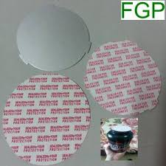
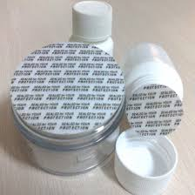
Induction Sealing Wads
These are used for sealing bottles . HS PET is used for industion sealing of PET bottles .
Used in Pharma bottles , Juice bottles , Oil Bottles etc

Slide 17
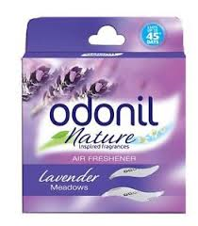
Room Freshner Packaging
Inner Pouches of room Freshners like ODONIL etc are packed in Metallised HS pet film

Slide 18
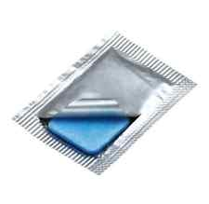
Mosquito Mat Packaging
Mosquito mat are packed in 48 ga HS PET and Met PET films

Slide 19
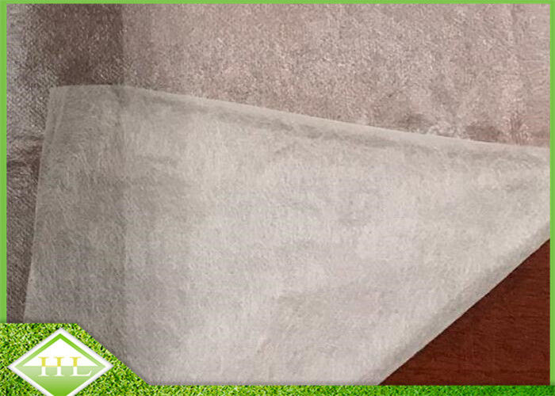
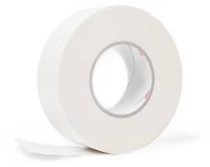
Electrical Insulation Tapes
HS PET is laminated to non woven PET to give strength . This laminate it then used to make Motor Insulation tape .

Slide 20
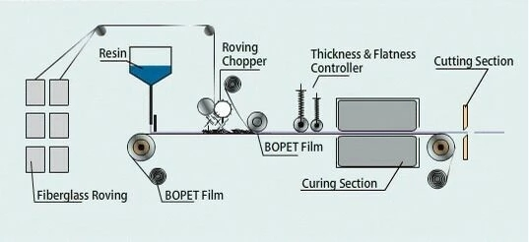
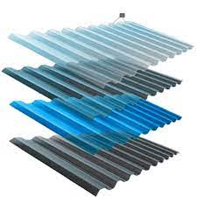
HS PET for FRP
Printed or un Printed HS PET films A581 types are laminated with FRP sheets .
For Outdoor or Harsh weather conditions UV HS pet films are also used .

Slide 21
High Seal Strength Films for Mono-Material Laminates
A551 type films have Seal Strength of 1000 gm or more.
These are best for mono-material laminates and heavy packaging applications.
The all-PET monomaterial flexible packaging can be used for a wide range of food and pharmaceutical product packages as well as for shampoo, conditioner, and other liquid personal care goods. Demand for such goods is expected to increase, particularly in ASEAN markets

Slide 22
Antifog HS PET film – A574
A574/ AF 574 film is inline AntiFog Coated PET film suitable for weld seal AF lidding applications.
This film also has some industrial uses.

Slide 23
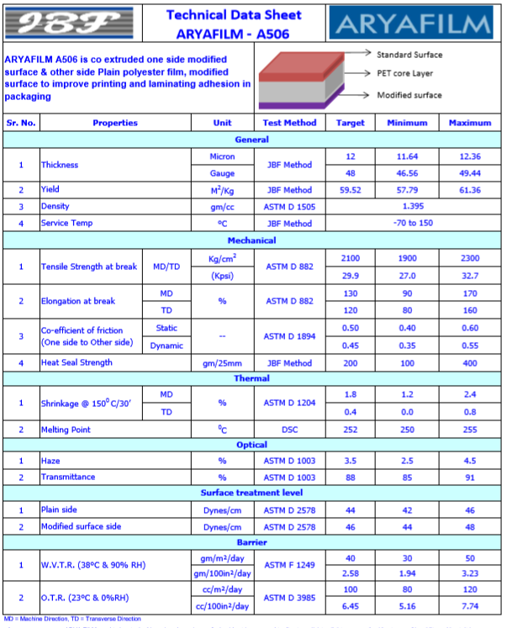
Co-Extruded PET A506 for High Bond
To replace
Terphane -10.21
Toray – PA10
Flex F-CSP
Ester EB104
In flexible Packaging

Slide 24
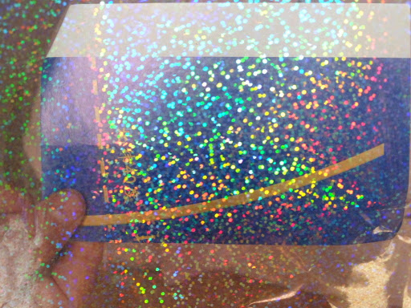

Holographic Embossable PET – A503
To replace
Terphane -10.21
Toray – PA10
Flex F-CSP
Ester EB104
In flexible Packaging

Slide 25
New Product Under Development
HS Met PET in 12 to 50 Micron
Chem HS PET films 12 to 50 micron
Both Side HS PET – 12 to 50 micron
250 Micron HS Pet Film
HS with Inline Food Grade Anti-Fog PET
UV Hs PET for FRP Application
White HS PET for Lidding
Antimony Free HS PET

Slide 26
Thank You

